Slide 1
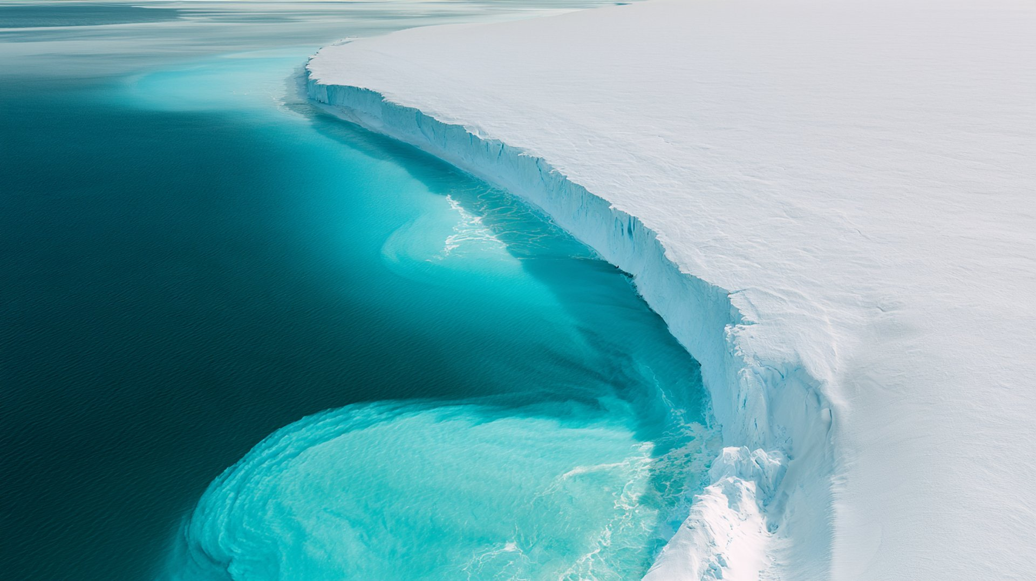


Water on Earth: Abundant, Yet Scarce
Almost all of the planet's water is salty, and most of the rest is frozen.
2.5% freshwater
1.2%
Surface & other water
~70%
68.7%
Glaciers & ice caps
of global freshwater withdrawals go to agriculture
97.5%
saltwater
2.1 billion
30.1%
Groundwater
people (1 in 4) still lacked safely managed drinking water in 2024
All water on Earth
Freshwater (2.5%)
Sources: USGS (distribution of Earth's water); FAO AQUASTAT (withdrawals); WHO/UNICEF JMP, 2025 (drinking water). Freshwater bar enlarged for visibility.
Notes:
Of all the water on Earth, 97.5% is salt water. Only 2.5% is fresh, and about two thirds of that is locked in glaciers and ice caps, roughly 30% is underground, and only about 1% is in lakes, rivers and other surface sources. At the same time, agriculture takes about 70% of the freshwater we withdraw, and 2.1 billion people, one in four, still lacked safely managed drinking water in 2024.

